Slide 1
Logos of the
Authors’ institutions
Logos of the
Authors’ institutions
Logos of the
Authors’ institutions
Darmstadt (Germany)
30th Sept. – 2nd Oct. 2026

Slide 2
Notes for the Authors
Do not add extra images to the title slide (except for your institution’s logo);
Modify the footer of content slides in the master slides: go to View → Slide Master; replace or delete the institution’s logo placeholders in the master slides.
ENJOY NET-ZERO FUTURE 2026 CONFERENCE!

Slide 10

Acknowledgements & Contact information (optional)
name.surname@example.com

Slide 11
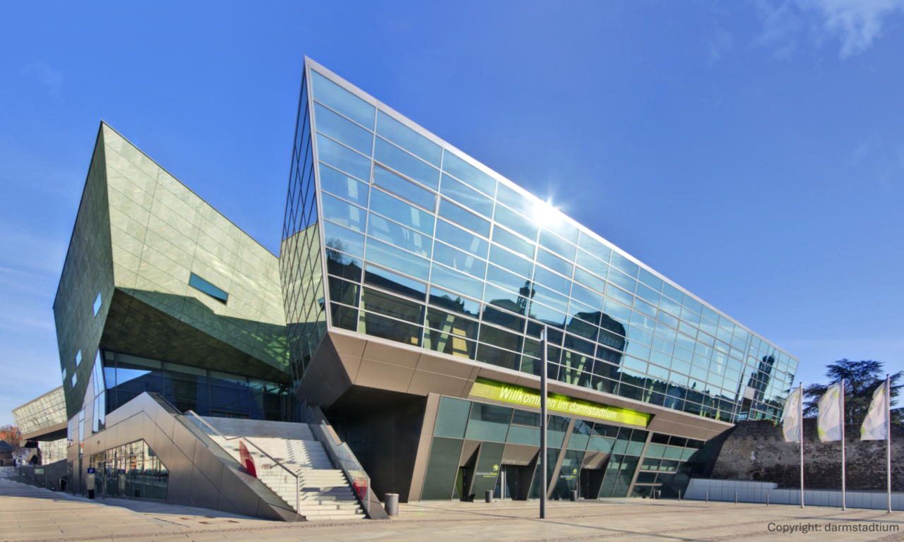
Thanks for your kind attention !
Any questions from the audience?

